Slide 1
Reasonableness and Statutes
Richard Warner

Slide 2
Reasonableness
Cost/benefit
custom and practice
Industry standard
Statutory requirements

Slide 3
Reasonableness Versus Specific Requirements.
Reasonableness requirements simply require reasonable safeguards against unauthorized access.
Alternatively, one can identify specific requirements that must be implemented.
Statutes take one approach or another or combine them.

Slide 4
The HIPAA Security Rule,
45 CFR § 164.306 (a) and (b)
a) General requirements. Covered entities and business associates must do the following:
(1) Ensure the confidentiality, integrity, and availability of all electronic protected health information the covered entity or business associate creates, receives, maintains, or transmits.
(2) Protect against any reasonably anticipated threats or hazards to the security or integrity of such information
.

Slide 5
HIPAA Security Rule,
45 CFR § 164.306 (c) and (e)
(c) Standards. A covered entity or business associate must comply with the applicable standards as provided in this section and in § 164.308, 164.310, 164.312, 164.314 and 164.316 with respect to all electronic protected health information.
(e) Maintenance. A covered entity or business associate must review and modify the security measures implemented under this subpart as needed to continue provision of reasonable and appropriate protection of electronic protected health information, and update documentation of such security measures in accordance with § 164.316(b)(2)(iii).

Slide 6
§164.308 Administrative safeguards.
(a) A covered entity or business associate must, in accordance with § 164.306:
  (1)
    (i) Standard: Security management process. Implement policies and procedures to prevent, detect, contain, and correct security violations.
    (ii) Implementation specifications:
      (A) Risk analysis (Required). Conduct an accurate and thorough assessment of the potential risks and vulnerabilities to the confidentiality, integrity, and availability of electronic protected health information held by the covered entity or business associate.

Slide 7
Specific Requirements: Pros and Cons
Pro:
  Predictability: you know what is required.
  Possibly, greater expertise.
Con:
  May easily become out of date.
  May not be flexible.
  May not require enough (agency capture).

Slide 8
Reasonableness
Our discussion uses the notion of expected gain and loss. The idea is familiar from everyday life.
Suppose that, on Monday, you want to go to dine on Brazilian food much more than you want to eat Mediterranean fare, but you go to the Mediterranean anyway.
Why?

Slide 9
The Explanation
You think it highly likely that the Brazilian restaurant is closed on Mondays while you are virtually certain the Mediterranean is open.
When you take the probability of being open into account, the expected gain of going to the Mediterranean restaurant makes going there a more attractive option than expected loss of going to the almost certainly closed Brazilian restaurant.

Slide 10
What Is The Required Level Of Care In Kline?
The landlord in Kline underinvested in security. How should a landlord decide how much to invest?
Our answer is that they should decide in a way analogous to the way you decided whether to go the Brazilian or Mediterranean restaurant.
Imagine a landlord Alissa deciding how much to invest to upgrade her current defenses.

Slide 11
Expected Harm From Current Defenses
Assume that she knows
  the probability for months of different types of attacks in the common areas given her current defenses, and
  the amount of harm each type of attack causes.
That allows her to determine the expected harm from attacks given her current defenses:
  Expected harm from current defenses = harm from attacks taking probability into account.

Slide 12
Reduced Expected Harm From Current Defenses
Next assume she knows the various possible improvements in defense available.
  The improvements do not ensure that there will never be an attack in the common areas, but they reduce the probability of an attack.
For any improvement, assume Alissa knows the new, reduced probability of attacks.
Then she can determine the reduction in expected harm from adopting an improvement:
  reduced expected harm from current defenses = harm from attacks taking reduced probability into account.

Slide 13
Knowledge Of Costs
Finally, assume Alice knows how much the various possible improvements cost.
  Costs here include not just Alissa’s time, effort, and money, but also the costs to tenants, such as increased rent as Alissa passes her increased costs on to her tenants and a loss of privacy from increased security surveillance from security personal and video cameras.
Then we have an answer to how much she should invest in security.

Slide 14
The Right Level of Investment
She should keep investing to reduce the expected harm until any further investment would spend more on security than the expected harm it avoids.
Investing less is wasteful because a large investment would cost less than the harm it avoids.
Investing more is also wasteful because the investment is great than the harm it avoids.

Slide 15
Do Landlords Know What They Need To Know?
Assume a landlord should decide how much to invest in security based on an expected gain and loss analysis.
Will they know what they need to know?
Will they know how much harm different types of attacks cause?
Will they know the probability of an attack before and after improvements in defenses?
Landlords are unlikely to have access to the necessary statistical studies—if indeed such studies exist.

Slide 16
When Do We Know?
Yes
No
Doubtful
Your restaurant choice
The T. J. Hooper
Driving under normal conditions
Hadley v. Baxendale
Wagon Mound cases
Landlord/tenant in Kline
Cybersecurity

Slide 17
Industry Standards
The majority’s answer is that landlords can find evidence of the degree of security required in the security practices of other landlords in similar buildings.
As the majority says the required level of protection is the “standard of protection commonly provided in apartments of this character and type in this community.”

Slide 18
Market Assumptions
It makes sense to treat industry practice as evidence of reasonableness—
  if renters can know the different degrees of protection different landlords offer,
  and if they avoid landlords who underinvest in security (landlords who ought to reduce expected harms by spending more), and rent instead from landlords who adequately invest (invest until any further investment would spend more on security than the expected harm it avoids).
  Then profit-driven landlords have an incentive to offer security/rent combinations renters see as acceptable.
Do you think renters behave this way?
A similar “Do defenders know what they need to know?” question arises for cybersecurity and is even more problematic to answer.

Slide 19
Data Breach Notification Laws
The laws require companies to publicly report “data breaches.” Three reasons:
  One, politically very popular.
  Two, it provides some statistics to security researchers about costs and probabilities.
  And three, it forces companies to improve their security.
    At least many claim so.

Slide 20
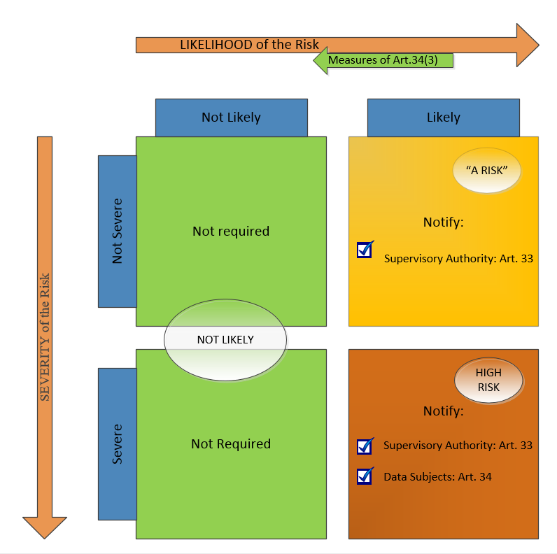
GRDP Data Breach Reporting

Slide 21
Doubts About Improvement
Data breach notification laws create an incentive to avoid breach reporting costs.
  The laws define the type of event a business must report.
    So they create an incentive to reduce reportable data breaches.
They do not create an incentive to improve security in regard to problems that do not manifest themselves as reportable data breaches.

Slide 22
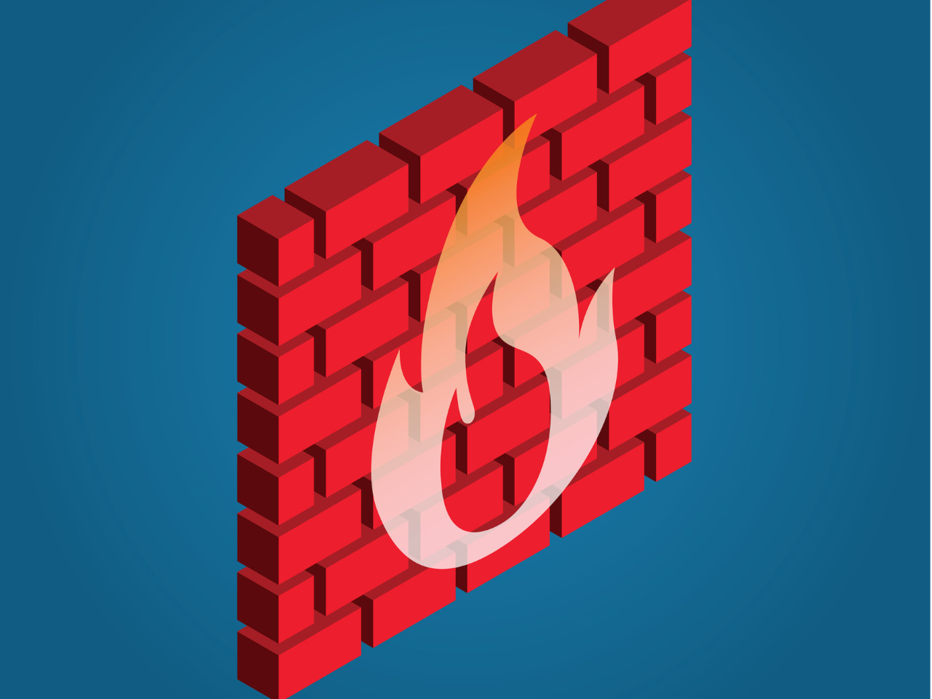

Private Rights of Action – Capital One
Capital One on AWS –- server can copy information from and to a URL
Data on the hackers’ website
Hackers gain access through a misconfigured firewall = Capital One “left the door open”
Hackers tell the server to send data to a URL the hacker control -- this is the SSFR.

Slide 23
Virginia’s Breach Notification Statute
“Breach of the security” = “unauthorized access and acquisition of unencrypted and unredacted computerized data that compromises the security or confidentiality of personal information . . . that causes, or the individual or entity reasonably believes has caused, or will cause, identity theft or other fraud.”

Slide 24
The Private Right of Action
An individual may recover “economic damages from a violation of this section.”

Slide 25
Overview
Virginia statute | Unauthorized access
Breach of confidence | Positive act of disclosure
Negligence | Unreasonableness
Litigation is expensive. A simple law suit will cost at least $10,000. Complex litigation will cost much much more.
Will governments take over the burden of suing?

