Slide 1
Net Neutrality and the FCC
Richard Warner

Slide 2
What Is Net Neutrality?
  Neutrality = not favoring one application over another. So:
(1) Non-discrimination rules that forbid operators of broadband networks to discriminate against third-party applications, content or portals and to exclude them from their network, and, perhaps:
(2) Mandating interconnection, non-discrimination, rate regulation and the adoption of standardized protocol interfaces such as TCP/IP.

Slide 3
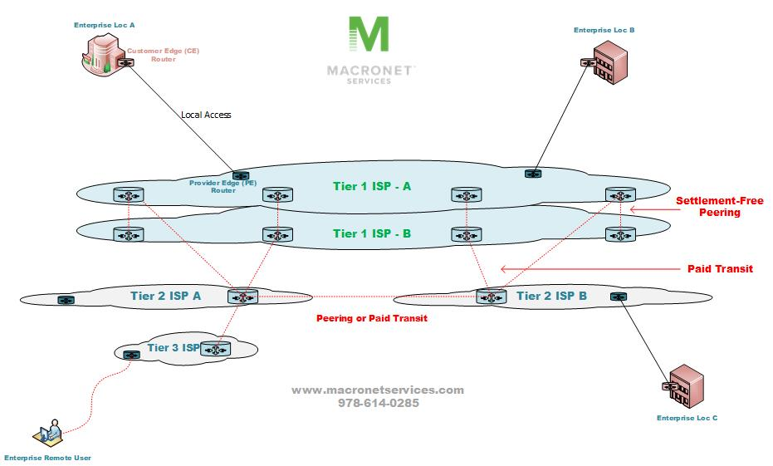
Comcast: market share of over 40% of all broadband internet subscriptions in the United States.
AT&T: market share of 66.50%.

Slide 4
FCC and Net Neutrality
FCC Regulates interstate and international communications by radio, television, wire, satellite and cable in all 50 states, the District of Columbia and U.S. territories.
It abandoned enforcing net neutrality in 2017.
Reinstated it in 2024.

Slide 5
Neutrality Rules
No Blocking. A broadband provider can't block lawful content, applications, services or nonharmful devices.
No Throttling. Broadband providers cannot slow down
  specific applications or services,
  traffic based on who sends it, where it's going, or what its content is.
No Paid Prioritization. A broadband provider cannot accept fees for favored treatment—no Internet fast lanes.

Slide 6
Legal Basis Befor e 2024 : Title II
The FCC declared broadband providers utilities under 47 U.S.C. 224:
(a) (1): The term ''utility'' means any person who is a local exchange carrier . . . who owns or controls poles, ducts, conduits, or rights-of-way used, in whole or in part, for any wire communications.
(f) Nondiscriminatory access: utility shall provide a cable television system or any telecommunications carrier with nondiscriminatory access to any pole, duct, conduit, or right-of-way owned or controlled by it.

Slide 7
Why Do This?
Three arguments:
  The argument from history.
  The privacy threat.
  The threat to free expression.

Slide 8
The End-To-End Principle
The end-to-end principle: when there is a choice about where to take an action that makes up part of an overall communication, that action should be taken by one of the two computers at either end of the communication, rather than by the computers along the path between the two endpoints.
So: Interpretative intelligence only at the Internet’s periphery.

Slide 9
“Dumb” Routers In the Middle
A router does not “understand” the data it transmits; it just hops packets efficiently on their way.
  It “knows” the address of the packets
  Otherwise, it does not “know” what the 0's and 1's mean.
Thus: no discrimination—that is: net neutrality.

Slide 10
The Argument from History
The end-to-end principle “dramatically expanded the uses to which data networks could be put and triggered the explosive growth of the Internet.”
  Jonathan E. Nuechterlein and Philip J. Weiser, Digital Crossroads: American Telecommunications Policy in the Internet Age 43 (2005).
Why? Because of non-discrimination.

Slide 11
Lawrence Lessig’s Points: 1
“First, because applications run on computers at the edge of the network, innovators with new applications need only connect their computers to the network to let their applications run.”
The end-to-end principle ensures that the Internet is a multi-purpose network—unlike the circuit switched phone network which is optimized for one use: making phone calls.

Slide 12
Lawrence Lessig’s Points: 2 and 3
“Second, because the design is not optimized for any particular existing application, the network is open to innovation not originally imagined.”
Third, because . . . the network owner can’t discriminate against some packets while favoring others–the network can’t discriminate against a new innovator’s design. If a new application threatens a dominant application, there’s nothing the network can do about it.”

Slide 13
The Privacy Threat: DPI Background
The sequences of 0’s and 1’s associated with particular applications come in characteristic patterns—“signatures.”
Deep packet inspection can identify those signatures and so read content created by particular applications.

Slide 14
Uses of Deep Packet Inspection
Network security: Detect viruses and spyware.
Network access: Enforce network-access rules.
CALEA compliance: Comply with government surveillance laws.
Acceptable use policies: Enforce acceptable-use policies..
Quality of service: Traffic control and bandwidth allocation
Tailored service: Offer and enforce different services plans.
Copyright: Filter traffic to remove copyrighted material.
Blocking, throttling, fast lanes.
Advertising.

Slide 15
The Privacy Threat
Governments could scan for content they find objectionable.
Businesses could scan (more than they already do) for:
  Advertising,
  Price discrimination
  Preferred treatment (“Gold card members”)

Slide 16
The Risk to Free Expression
If we abandon neutrality, many warn of an Internet from which free expression has almost completely vanished because
A few dominant ISPs could control what information is available and how much it costs to access it.
Compare cable television: a few massive companies control what we see and determine how much it costs to see it.

Slide 17
Lessig’s Warning
Without neutrality, “major industries . . . would face huge tariffs for fast, secure Internet use—all subject to discriminatory and exclusive deal making with telephone and cable giants.”
    Lawrence Lessig and Robert W. McChesney, “No Tolls on The Internet,” Washington Post, June 8, 2006.

Slide 18
What Is Bad About Neutrality?
Arguably, it is bad economics.
“The arguments offered in favor of network neutrality regulation have, to date, exhibited a staggering lack of economic rigor.”
      Sidak, A Consumer-Welfare Approach to Network Neutrality Regulation of the Internet, 2006.

Slide 19
A Worry
A rational economic actor will engage in an activity up to the point at which the costs to that actor equal the expected benefits to that actor.
What happens when an actor does not bear the full cost of the activity?
The actor will engage in the activity beyond the point at which the costs equal the expected benefits.
This wastes resources.
Net neutrality means that Internet users do not bear the full cost of their use.

Slide 20
A Question
Given the economic incentives, what is the best way to maximize consumer welfare on the Internet?
That is a complicated economic, moral, and political question.

Slide 21
Legal Basis 2024
“BIAS [broadband Internet access service] connections are absolutely essential to modern day life, facilitating employment, education, healthcare, commerce, community-building, communication, and free expression.”
  Para. 26
“Upon today’s reclassification of BIAS as a Title II telecommunications service, we rely on our authority in sections 201 and 202 of the Act, along with the related enforcement authorities of sections 206, 207, 208, 209, 216, and 217, for the open Internet rules we adopt today to address practices that are unjust, unreasonable, or unreasonably discriminatory.”
  Para. 29.

Slide 22
FCC’s Authority: How Broad?
How broad is the FCC’s authority? Could it conduct a general review of the security of the United States’ communications infrastructure?
In Huawei v. FCC, the court upheld the FCC’s finding that Huawei’s products posed a national security threat. The court, however, holds that “[a]ssessing security risks to telecom networks falls in the FCC's wheelhouse.” (p.___.)
Note: There is no restriction to just national security.
In In the Matter of Secure Internet Routing, the FCC Notice of Inquiry, the FCC proposes a general review of routing security.

