Slide 1
The Computer Fraud and Abuse Act; Facebook, hiQ
Richard Warner, Professor, Chicago-Kent College of Law

Slide 2
Facebook v. Power Ventures
There are a lot of social networking sites: Facebook, QQ, WeChat, QZone, Tumblr, Instagram, Twitter, Baidu Tieba, Skype, Viber, Sina Weibo and so on.
Suppose you have accounts on several of those.
Power Ventures allowed you to post on multiple sites at once.
Power Venture’s users gave it their user names and passwords so it could log in as their agent to make posts.

Slide 3
In Facebook v. Power Ventures
Power Ventures

Slide 4
The Data Power Ventures Wanted
“When a Facebook user directs Power.com to access the Facebook website, an unauthorized copy of the user’s profile page is created.”
  Facebook v. Power Ventures, 2010 WL 3291750, United States District Court, N.D. California, p. 8.
Note: you can only view Facebook profiles if you are logged in as a Facebook user. They are not publicly accessible.
The question: Is Power Ventures authorized to use them when it logs in using someone else’s user name and password?

Slide 5
Breaking and Entering Versus Trespass
The model for the CFAA is burglary, not trespass.
Trespass = unauthorized
  Access to land
  Use of property that impairs value or harms a protected interest.
Burglary requires
  Breaking = violation of a security device designed to exclude people
    State v. Newbegin, 25 Me. 500, 504 (1846)
  Entering

Slide 6

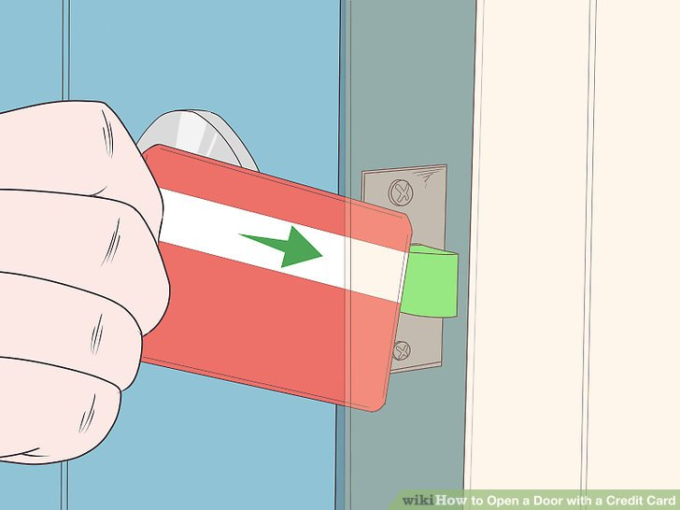
A “Breaking” Example
Violation of a security device designed to exclude people, and a violation of norms.

Slide 7
What Is Breaking In?
Breaking need not involve force or violence
  Opening of closed, but unlocked door or window.
    State v. Boon, 35 N.C. 244, 246 (1852)
  But entering through a door left ajar or an open window is not breaking
    State v. Boon, 35 N.C. 244, 246 (1852)

Slide 8
CFAA Background
First passed in 1984 as a purely criminal statute.
Amended in 1992 to allow civil actions.
  Interpretation of terms uniform in both contexts:
    “As a consequence, even in civil cases brought under the CFAA, the canon of strict construction of criminal statutes or what is referred to as the rule of lenity is followed.”
      WEC Carolina Energy Solutions LLC v. Miller, 687 F.3d 199 (4th Cir. 2012)
    Lenity: Ambiguities in a criminal statute about prohibitions and penalties must be resolved in favor of the defendant if it is not contrary to legislative intent.

Slide 9
Obtaining Information
A 1996 amendment: information includes information stored in intangible form.
    The National Information Infrastructure Protection Act of 1995,
Obtaining information: includes merely viewing information without downloading or copying it.
    Healthcare Advocates, Inc. v. Harding, Earley, Follmer & Frailey, 497 F. Supp.2d 627, 648 (E.D. Pa. 2007).

Slide 10
Computer Fraud and Abuse Act
CFAA 18 U.S.C. § 1030(a)(2)(C):
  Criminal and civil liability for whoever (a) “intentionally accesses a computer (b) without authorization . . , and (c) thereby obtains ... information from any . . . computer.”

Slide 11
A Common Pattern
Facebook v. Power Ventures: the distributed information is social networking sites.
There are a lot: Facebook, QQ, WeChat, QZone, Tumblr, Instagram, Twitter, Baidu Tieba, Skype, Viber, Sina Weibo and so on.
Suppose you have accounts on several of those.

Slide 12
Power Venture’s Business Idea
You would like a way to post on all of them from just one site.
Solving that problem was the idea behind Power Venture.
  You could post on all your sites at once.
Power Ventures did what many do:
  collect scattered information
  make it conveniently accessible.

Slide 13
Facebook Objects
Facebook objects to the Power Ventures access and claims it is illegal.
The court agreed.
“Do you think Power Ventures should be able to access Facebook?”

Slide 14
The Data Power Ventures Took
“When a Facebook user directs Power.com to access the Facebook website, an unauthorized copy of the user’s profile page is created.”
  Facebook v. Power Ventures, 2010 WL 3291750, United States District Court, N.D. California, p. 8.

Slide 15
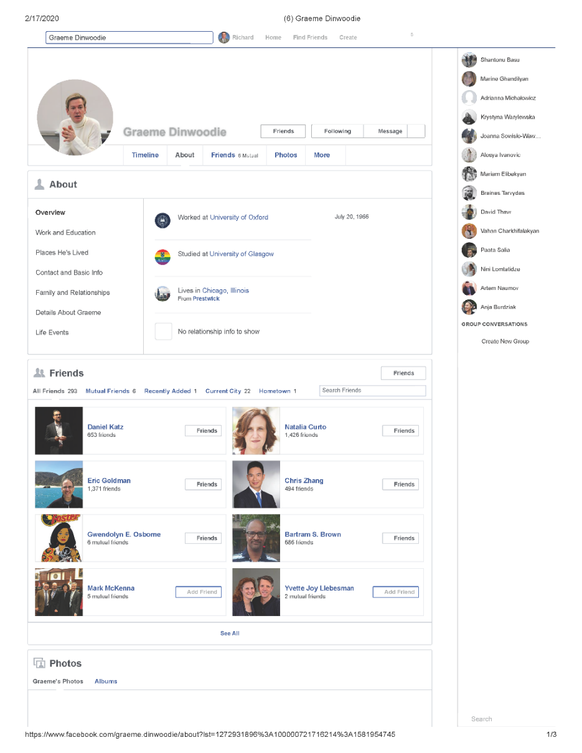
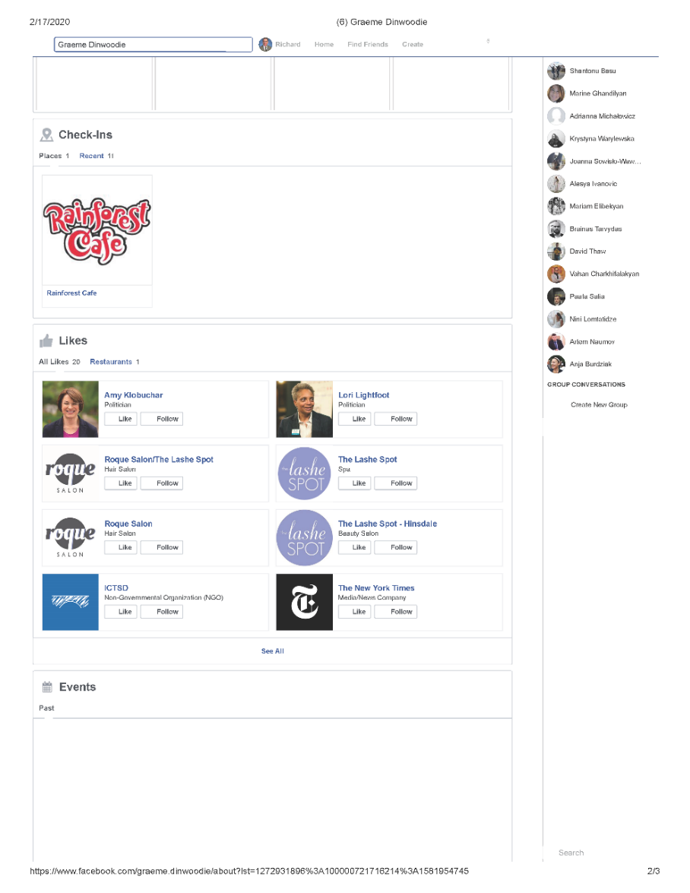
What Did They Copy?

Slide 16
The Letter Revoking Consent
“On December 1, 2008, Facebook first became aware of Power’s promotional campaign and, on that same date, [1] Facebook sent a “cease and desist” letter to Power instructing Power to terminate its activities. Facebook tried to get Power to sign its Developer Terms of Use Agreement and enroll in Facebook Connect; [2] Power resisted. [3] Facebook instituted an Internet Protocol (“IP”) block in an effort to prevent Power from accessing the Facebook website from Power’s IP address. [4] Power responded by switching IP addresses to circumvent the Facebook block. [5] Through this period, Power continued its promotion even though it acknowledged that it took, copied, or made use of data from Facebook.com without Facebook’s permission.”

Slide 17
CFAA§1030(a)(2)(C)
Facebook sued under this provision:
  Criminal and civil liability for whoever (a) “intentionally accesses a computer (b) without authorization . . , and (c) thereby obtains ... information from any protected computer.”
Power Ventures intentionally accessed Facebook’s computers, and It obtained information by doing so.
Was its access unauthorized?
  Power Ventures did have permission from Facebook’s users to access their accounts.

Slide 18
The Courts Analogy
Suppose that a person wants to borrow a friend’s jewelry that is held in a safe deposit box at a bank.
The friend gives permission for the person to access the safe deposit box and lends him a key.
The person decides to visit the bank while carrying a shotgun.
The bank ejects the person from its premises and bans his reentry. The gun-toting jewelry borrower could not then reenter the bank, claiming that access to the safe deposit box gave him authority to stride about the bank’s property while armed.

Slide 19
Who Makes Money from the Data?
When you sign up for Connect, you agree to these rules (https://developers.facebook.com/policy):
  Don't sell, license, or purchase any data obtained from us or our services.
  Don't transfer any data that you receive from us (including anonymous, aggregate, or derived data) to any ad network, data broker or other advertising or monetization-related service.
So how Power Ventures make enough money?

Slide 20
hiQ v. LinkedIn
hiQ is a data analytics business. It analyzes publicly available data to categorize employees for their employers. Two categories:
  Keeper—estimates the risk an employee will leave for another job.
  Skill mapper—summarizes employees’ skills
hiQ only uses data from LinkedIn.
  Without that data, hiQ goes out of business.

Slide 21
Scrapper Code
connection = ur.urlopen(“some_website")
content = connection.read()

Slide 22
hiQ’s Business
hiQ is a data analytics business. It analyzes publicly available data to categorize employees for their employers. Two categories:
  Keeper—estimates the risk an employee will leave for another job.
  Skill mapper—summarizes employees’ skills
hiQ only uses data from LinkeIn.
  Without that data, hiQ goes out of business.

Slide 23
The Revocation Letter
“On May 23, 2017, LinkedIn sent a letter demanding that hiQ “immediately cease and desist unauthorized data scraping and other violations of LinkedIn’s User Agreement.”
  hiQ was founded in 2012, and had searched LinkedIn since its founding.
  LinkedIn was acquired by Microsoft in 2016.

Slide 24
The CFAA Issue
“The key question regarding the applicability of the CFAA in this case is whether, by continuing to access public LinkedIn profiles after LinkedIn has explicitly revoked permission to do so, hiQ has “accesse[d] a computer without authorization” within the meaning of the CFAA.”

Slide 25
Public Versus Private Information
The factual difference between hiQand Power Ventures is that Facebook does not allow public access to the information Power Ventures wanted while LinkedIn does allow public access to the information hiQ wants.
This difference is why the hiQ court says Power Ventures does not apply.

Slide 26
Outline of the Argument
The online contract does not define unauthorized access for purposes of the CFAA.
The statutory language is ambiguous.
So the court looks at
  legislative intent
  the consequences of proposed interpretations.

Slide 27
LinkedIn’s Terms of Use
Is the question settled by the Terms of Use Agreement?
  “You agree that you will not: . . .
  Develop, support or use software, devices, scripts, robots, or any other means or processes (including crawlers, browser plugins and add-ons, or any other technology or manual work) to scrape the Services or otherwise copy profiles and other data from the Services.”
The court holds that this does not define authorized access for purposes of the CFAA.
  The court is in the 9th Circuit.

Slide 28
LinkedIn’s General Policy
“LinkedIn has taken steps to protect the data on its website from what it perceives as misuse or misappropriation.”
It “blocks . . . 95 million . . . attempts to scrape data every day, and has restricted over 11 million accounts suspected of violating its User Agreement, including through scraping.”
Technical details:
  “robots.txt” file
  Quicksand (detects scraping)
  Sentinel (slows, limits, IP addresses
  Org Block (a blacklist)

Slide 29
The Argument from 20 Years Ago
First: The growth and vitality of the Internet depend on e-mail communication, hyperlinking, and the search-engine index.
Second: These features thrive on implied-consent to access.
Third: Recognizing a right to prevent access–potentially—reduces implied-consent to access and hence threatens the growth and vitality of the Internet.
Conclusion: We should exercise considerable care in creating rights to exclude on the Internet.

Slide 30
The Appeals Court On Information Monopolies
“We agree with the district court that giving companies like LinkedIn free rein to decide, on any basis, who can collect and use data—data that the companies do not own, that they otherwise make publicly available to viewers, and that the companies themselves collect and use—risks the possible creation of information monopolies that would disserve the public interest.”

Slide 31
Requiring a Login
What if LinkedIn required logging in with a user name and password to view data that was, at the time of the case, accessible to the general public without logging in?
That is in fact what LinkedIn did. Today, you cannot view a LinkedIn user’s full profile without joining LinkedIn and logging in.
Does that mean that a cease and desist letter can make future access unauthorized for purposes of the CFAA, at least as long as the person seeking access evades security devices design to prevent the access?

Slide 32
A Victory?
hiQ v. LinkedIn is a victory for hiQ, but subsequent developments were not.
hiQ went out of business and ultimately settled the case. hiQ agreed to pay Microsoft $500,000 and admitted that it violated the CFAA.
Part of the explanation may be that it emerged that hiQ employed people to log in to LinkedIn to confirm that the data hiQ use to profile an individual was indeed the data of that individual.
When LinkedIn discovered the hiQ employees and discontinued their accounts (as permitted under the Terms of Use) the employees opened new accounts under fake names. That is arguably breaking in.

Slide 33
Tentativeness of the Holding
The court’s ruling 2019 ruling:
    At this preliminary injunction stage, we do not resolve the companies’ legal dispute definitively, nor do we address all the claims and defenses they have pleaded in the district court. Instead, we focus on whether hiQ has raised serious questions on the merits of the factual and legal issues presented to us, as well as on the other requisites for preliminary relief.
Its conclusion is only that it is “likely that when a computer network generally permits public access to its data, a user’s accessing that publicly available data will not constitute access without authorization under the CFAA.”
For individuals and businesses using scrappers, hiQ v. LinkedIn provides less assurance of lack of liability than may first appear.

